Slide 1
Cricket Academy Management Systems By Kalpesh & Prajwal

Slide 2

Introduction to Cricket Academy Management System
The Cricket Academy Management System (CAMS) is a comprehensive application designed to address the unique operational needs of a cricket academy. It serves as a centralized platform to manage the day-to-day administrative tasks of a sports academy, specifically focusing on the organization of player and team records, coach assignments, fee tracking, attendance management, and training schedules.

Slide 3

Technology used
Front end :- Python Tkinter
Backend :- SQL
Software :- PyCharm, MySQL Workbench

Slide 4

Key Features of Management Systems
Effective include
features such as player registration, scheduling, and performance tracking. These tools help coaches and administrators manage day-to-day operations while ensuring that athletes receive the necessary support for their
.

Slide 5

Objectives
The main objective of the Cricket Academy Management System (CAMS) is to develop an efficient and effective Database Management System (DBMS) tailored to the unique requirements of a cricket academy.

Slide 6
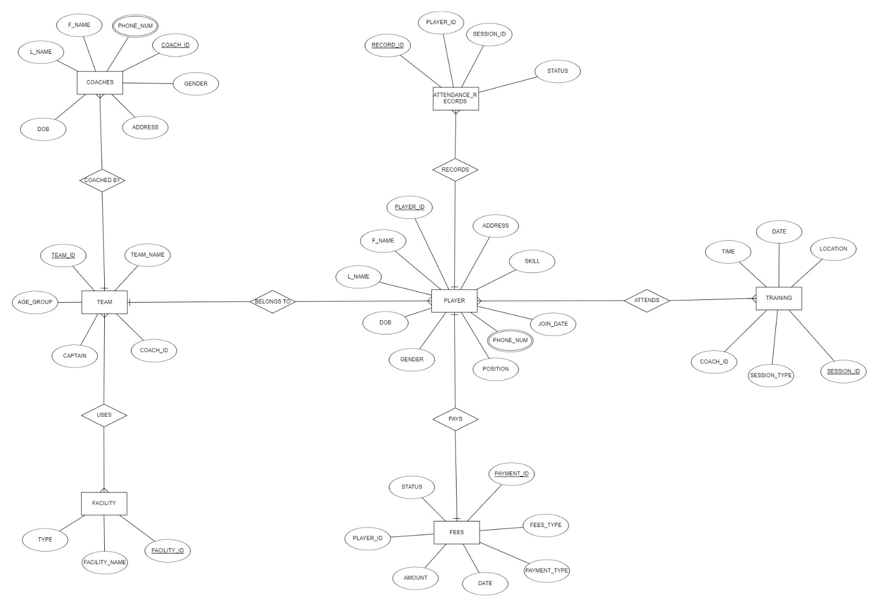
ER Diagram

Slide 7
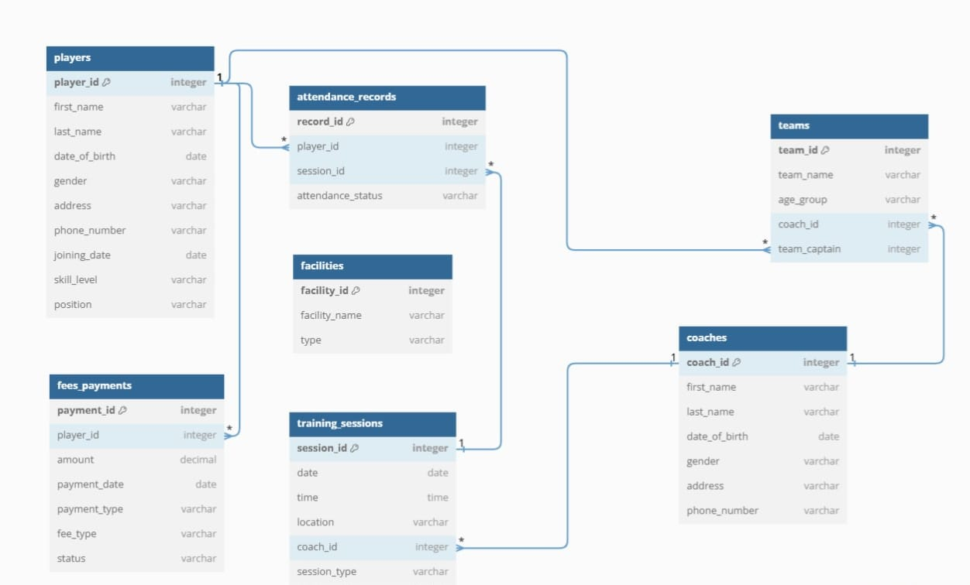
Schema Diagram

Slide 8

Challenges in Implementation
While implementing a management system can yield numerous beneﬁts, challenges such as
and training requirements must be addressed. A well-planned strategy is essential to ensure a smooth transition and maximize the system's potential.

Slide 9

Results
The Cricket Academy Management System (CAMS) successfully achieved its intended objectives, providing a comprehensive solution for managing data and streamlining administrative tasks within the cricket academy.

Slide 10


Conclusion and Future Outlook
In conclusion, optimizing performance through
is essential for modern cricket training. As technology continues to
evolve, academies must adapt and innovate to remain competitive and
provide the best possible support for their players.

Slide 11
Thanks!

